Slide 1
Introducing Group Policy

Slide 2
What is the configuration management?
Configuration management is a centralized approach to applying one or more changes to more than one user or computer. The key elements of configuration management are:
Setting. A setting also is known as a centralized definition of a change. The setting brings a user or computer to a desired configuration state.
Scope. The scope of a change is the number of computers or users that the setting affects.
Application. The application is a mechanism or process that ensures that the setting applies to users and computers within the scope.
Group Policy is a framework in Windows operating systems with components that reside in Active Directory Domain Services (AD DS), on domain controllers, and on each Windows server and client. With these components, you can manage configuration in an AD DS domain.

Slide 3
Overview of Group Policy tools and consoles
The most basic component of Group Policy is an individual policy setting. An individual policy setting also is known as a policy. The policy defines a specific configuration change that you can apply, such as a policy setting that prevents a user from accessing registry editing tools. If you define that policy setting, and then apply it to the user, the user will be unable to run tools such as REGEDIT (regedit.exe).
In the Group Policy Management Editor window, you can define a policy setting by double-clicking it.
The policy setting Properties dialog box appears. Policy settings in the area called Administrative
Templates can have three states: Not Configured, Enabled, and Disabled.
In a new GPO, every policy setting defaults to Not Configured. This means that the GPO does not modify the existing configuration of that particular setting for a user or computer. If you enable or disable a policy setting, a change is made to the configuration of users and computers to which the GPO is applied. When you return an Administrative Template setting to its Not Configured value, you return it to its default value. Some settings remain configured on the computer even if you remove the setting from the GPO.

Slide 4
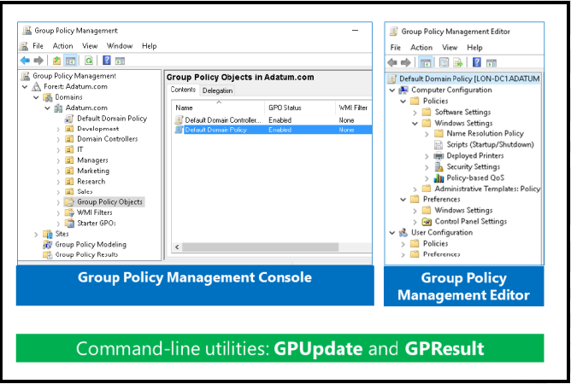
Overview of Group Policy tools and consoles

Slide 5
Overview of Group Policy tools and consoles
Computer Configuration and User Configuration There are two major divisions of policy settings: computer settings, which the Computer Configuration node contains, and user settings, which the User Configuration node contains:
The Computer Configuration node contains the settings that are applied to computers, regardless of who logs on to them. Computer settings apply when the operating system starts, during background refreshes, and every 90–120 minutes thereafter.
The User Configuration node contains settings that apply when a particular user signs in to the computer, during background refreshes, and every 90–120 minutes thereafter.

Slide 6
Overview of Group Policy tools and consoles
Within the Policies nodes, under the Computer Configuration node and the User Configuration node, are a hierarchy of folders that contain policy settings.

Slide 7
Benefits of using Group Policy
Group Policy is a powerful administrative tool. You can use GPOs to push various settings to a large number of users and computers.
Applying security settings
Managing desktop and application settings
Deploying software
Managing Folder Redirection
Configuring network settings

Slide 8
Group Policy objects
You define policy settings within a GPO. A GPO is an object that contains one or more policy settings that apply to one or more configuration settings for a user or a computer.
You manage GPOs by using the GPMC. The GPMC displays GPOs in a container named Group Policy Objects.
Can be edited with Group Policy Management Editor
Applied to a specific level in the AD DS hierarchy

Slide 9
Group Policy objects
To create a new GPO in a domain, right-click the Group Policy Objects container, click New, and then specify a name for the GPO.
To modify the configuration settings in a GPO, right-click the GPO, and then click Edit. This opens the Group Policy Management Editor window.
To create a GPO in Windows PowerShell, you run the following cmdlet:
New-GPO -Name “Sales GPO” -comment "This is the sales GPO"
Notes:
It is also possible to create a GPO and link it to the domain or an OU when it is created, by right-clicking the container, and then clicking Create a GPO in the domain and link it here.

Slide 10
Overview of GPO scope
The configuration changes in a GPO do not affect computers or users in your organization until you specify the computers or users to which the GPO applies. This is called scoping a GPO. The scope of a GPO is the collection of users and computers that will apply the settings in the GPO.
Several methods to manage the scope of GPOs.
The first is the GPO link. You can link GPOs to sites, domains, and OUs in AD DS. The site, domain, or OU then becomes the maximum scope of the GPO. All computers and users within the site, domain, or OU, including those in child OUs, are affected by the configurations that the policy settings in the GPO specify.
You can further narrow the scope of the GPO with one of two types of filters.
With security filters, you can use permissions to specify to which users, computers, or members of security groups the GPO does or does not apply.
Windows Management Instrumentation (WMI) filters specify a scope by using the characteristics of a system, such as operating system version or free disk space. Use security filters and WMI filters to narrow or specify the scope within the initial scope created by the GPO link.

Slide 11
Overview of GPO inheritance
You can create and link GPOs to a site, domain, or OU. When you apply multiple GPOs to the same container, this aggregates the settings in the GPOs. For most policy settings, the GPO with the highest precedence and that contains the specific setting determines the setting’s final value. For a few settings, the final value is the combination of values across GPOs.
GPOs are processed on a client computer in the following order:
1. Local GPOs
2. Site-level GPOs
3. Domain-level GPOs
4. OU GPOs, including any nested OUs, starting with the OU farthest from the user or computer object

Slide 12
Overview of GPO inheritance
GPOs that apply to higher-level containers pass through to all subcontainers in that part of the Active Directory tree. For example, a policy setting that you apply through a GPO linked to an OU also applies to any child OUs below it. The local GPO is processed first, and the OU to which the computer or user belongs is processed last. The last GPO processed is the effective setting.
Several Group Policy options can alter this default inheritance behavior. These options include:
Link Order. Use this option to set the precedence order for GPOs linked to a given container. The GPO link with a link order of one has the highest precedence on that container. If you change the link order, it does not have an effect unless GPOs that link to the same location have conflicting settings.
Enforced. With this option you can specify that a GPO takes precedence over any GPOs that link to child containers. Additionally, a GPO that the Windows operating system enforces at the domain level overrides a GPO that it enforces at an OU level. You typically enforce a GPO to ensure that computers use company-wide settings and that departmental administrators do not override these settings by creating other GPOs.
Block Inheritance. With this option you can prevent an OU or domain from inheriting GPOs from any parent containers. Enforced GPO links will always be inherited. Typically, you block inheritance to enable a department to manage Group Policy settings separately from the rest of the organization.
Link Enabled. The ability to specify whether a Windows operating system processes a specific GPO link for the container to which it links. When you do not enable a link, the Windows operating system does not process the GPO. Typically, this is done during troubleshooting when you want to disable the processing of a GPO to eliminate it as a source of configuration errors.

Slide 13
The Group Policy Client service and client-side extensions
It is important to understand how group policies apply on client computers. The steps below explain the process:
When a Group Policy refresh begins, a service that is running on all Windows-based computers, known as the Group Policy Client service in Windows Vista and later and Windows 2008 and later determines which GPOs apply to the computer or user.
The Group Policy Client service downloads any GPOs that are not cached already.
Group Policy client-side extensions interpret the settings in a GPO and make appropriate changes to the local computer or to the currently signed-in user. There are client-side extensions for each major category of policy setting. For example, there is a security client-side extension that applies security changes, a client-side extension that executes startup and logon scripts, a CSE that installs software, and a client-side extension that makes changes to registry keys and values. Each Windows operating system version has added client-side extensions to extend the functional reach of Group Policy, and there are several dozen client-side extensions in Windows operating systems.

Slide 14
The Group Policy Client service and client-side extensions
One of the more important concepts to remember about Group Policy is that it is client driven. The Group Policy Client service pulls GPOs from the domain, triggering the client-side extensions to apply settings locally. Group Policy is not a push technology.
You can see the installed client-side extensions on a computer by locating the HKLM\Software\Microsoft \Windows NT\CurrentVersion\Winlogon\GPExtensions key in the registry

Slide 15
The Group Policy Client service and client-side extensions
Group Policy refresh
Policy settings in the Computer Configuration node apply at system startup and then every 90–120 minutes thereafter.
Policy settings in the User Configuration node apply at sign in and then every 90–120 minutes thereafter. The application of policies is called Group Policy refresh.
You also can force a policy refresh by using the gpupdate command.

Slide 16
New features in Group Policy in Windows Server 2016

